Slide 1
May 3, Tuesday
We will meet at the
Planetarium, CPB first floor
10:50 AM
Show: Blackholes
(extra credit)
Comprehensive Final Exam: May 10, 11:00 am - 1:30 pm

Slide 2
ASTRONOMY I
Chapter 8
EARTH AS A PLANET

Slide 3
Chapter 8
EARTH AS A PLANET
8.1 The Global Perspective
8.2 Earth’s Crust
8.3 Earth’s Atmosphere
8.4 Life, Chemical Evolution, and Climate Change
8.5 Cosmic Influences on the Evolution of Earth
By the end of this section, you will be able to:
Describe the components of Earth’s interior and explain how scientists determined its structure
Specify the origin, size, and extent of Earth’s magnetic field

Slide 4
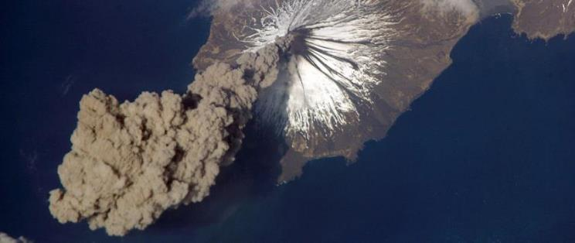
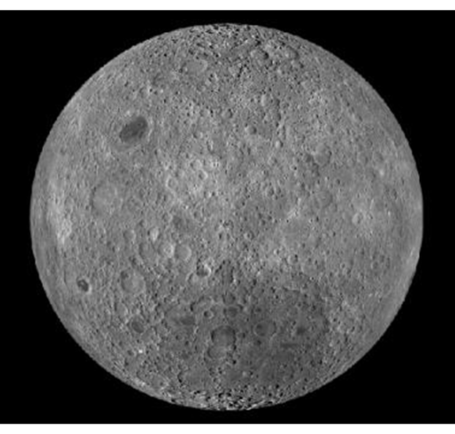
Thinking Ahead…
Airless worlds in our solar system seem to be peppered with large and small craters. Earth, on the other hand, has few craters, but a thick atmosphere and much surface activity.
Active Geology. This image, taken from the International Space Station in 2006, shows a plume of ash coming from the Cleveland Volcano in the Aleutian Islands. Although the plume was only visible for around two hours, such events are a testament to the dynamic nature of Earth’s crust. (credit: modification of work by NASA)
In this chapter:
We examine the composition and structure of our planet with its envelope of ocean and atmosphere.
We ask how our terrestrial environment came to be the way it is today, and how it compares with other planets.
Our Cratered Moon

Slide 5
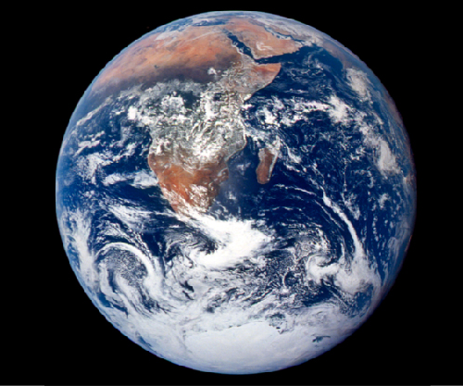
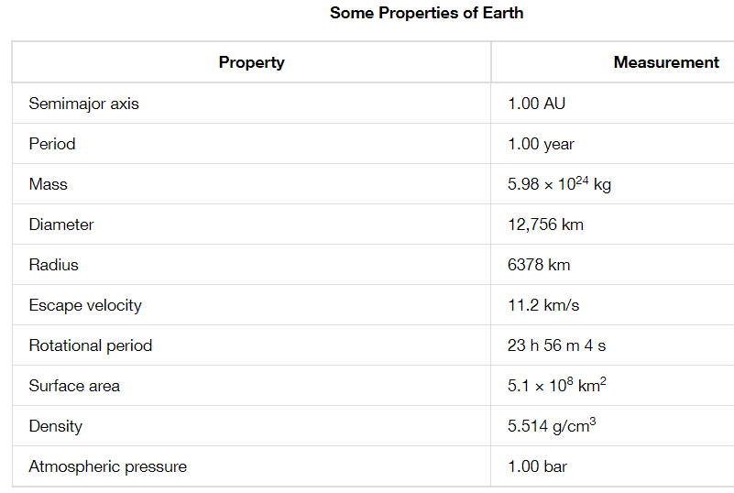
Earth
Diameter: approximately 12,760 kilometers
Composition: heavy elements such as iron, silicon, and oxygen
Orbit: Nearly Circular
Temperature: “Just Right” to support liquid water and “Life”
Blue Marble. This image of Earth from space, taken by the Apollo 17 astronauts, is known as the “Blue Marble.” This is one of the rare images of a full Earth taken during the Apollo program; most images show only part of Earth’s disk in sunlight. (credit: modification of work by NASA)

Slide 6
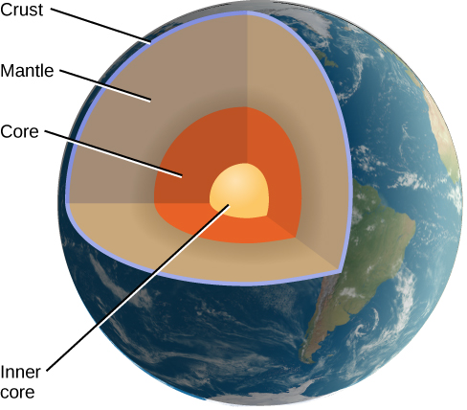
Earth’s Interior
Our only direct experience is with the outermost skin of Earth’s crust, a layer no more than a few kilometers deep.
The structure of material in Earth’s interior is probed by measuring the transmission of seismic waves through Earth.
Oceanic Crust:
55% of Earth’s Surface
6 kilometers thick
Composed of volcanic rock Basalt (silicon, oxygen, iron, aluminum, magnesium)
Continental Crust:
45% of the Earth’s Surface
20-70 kilometers thick
Granite (silicon and oxygen)
The Crust only makes up 0.3% of the total mass of the Earth. Its average density is 3 g/cm³
Interior Structure of Earth. The crust, mantle, and inner and outer cores (solid and liquid, respectively) as shown as revealed by seismic studies.

Slide 7
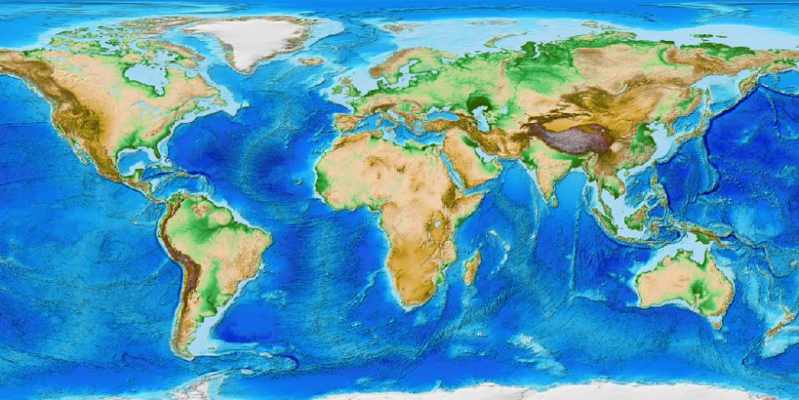
Earth’s Crust
This computer-generated image shows the surface of Earth’s crust as determined from satellite images and ocean floor radar mapping. Oceans and lakes are shown in blue, with darker areas representing depth. Dry land is shown in shades of green and brown, and the Greenland and Antarctic ice sheets are depicted in shades of white. (credit: modification of work by C. Amante, B. W. Eakins, National Geophysical Data Center, NOAA)

Slide 8
Earth’s Interior
Mantle:
Largest of the Earth
Depth: 2900 kilometers
More or less solid, but under pressure it can deform and flow slowly
Density: 3.5 – 5 g/cm³
Eject as volcanoes
Core:
Diameter: 7000 kilometers
Larger than Mercury
Outer core is liquid (iron, nickel, sulfur)
Inner core is probably solid
Interior Structure of Earth. The crust, mantle, and inner and outer cores (solid and liquid, respectively) as shown as revealed by seismic studies.

Slide 9
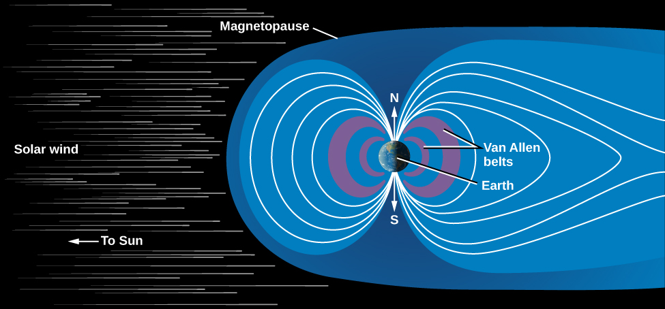
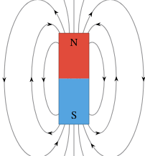
Magnetic Field and Magnetosphere
We can find additional clues about Earth’s interior from its magnetic field.
Our planet behaves in some ways as if a giant bar magnet were inside it, aligned approximately with the rotational poles of Earth.
This magnetic field is generated by moving material in Earth’s liquid metallic core.
A cross-sectional view of our magnetosphere (or zone of magnetic influence), as revealed by numerous spacecraft missions. Note how the wind of charged particles from the Sun “blows” the magnetic field outward like a wind sock.
As the liquid metal inside Earth circulates, it sets up a circulating electric current.
When many charged particles are moving together like that—in the laboratory or on the scale of an entire planet—they produce a magnetic field.

Slide 10
Magnetic Field and Magnetosphere
When a charged particle encounters a magnetic field in space, it becomes trapped in the magnetic zone.
Above Earth’s atmosphere, the field traps small quantities of electrons and other atomic particles.
A cross-sectional view of our magnetosphere (or zone of magnetic influence), as revealed by numerous spacecraft missions. Note how the wind of charged particles from the Sun “blows” the magnetic field outward like a wind sock.
Magnetosphere: the zone within which Earth’s magnetic field dominates over the weak interplanetary magnetic field that extends outward from the Sun.
Van Allen Belts: The regions of high-energy ions

Slide 11
Chapter 8
EARTH AS A PLANET
8.1 The Global Perspective
8.2 Earth’s Crust
8.3 Earth’s Atmosphere
8.4 Life, Chemical Evolution, and Climate Change
8.5 Cosmic Influences on the Evolution of Earth
By the end of this section, you will be able to:
Denote the primary types of rock that constitute Earth’s crust
Explain the theory of plate tectonics
Describe the difference between rift and subduction zones
Describe the relationship between fault zones and mountain building
Explain the various types of volcanic activity occurring on Earth

Slide 12
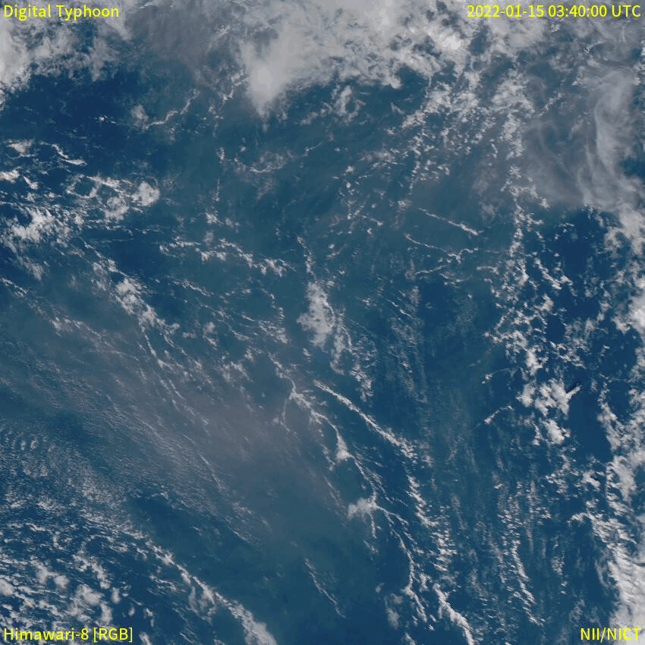

Composition of the Crust
Earth’s crust is a dynamic place and is most active.
Volcanic eruptions, erosion, and large-scale movements of the continents rework the surface of our planet constantly
Many of the geological processes described in this section have taken place on other planets as well, but usually in their distant pasts.
Jupiter’s moon Io has many active volcanoes.
Satellite images of the 15 January 2022 eruption of Hunga Tonga-Hunga Haʻapai
Horseshoe Bend, Paige Az.
Colorado River carved 1000 ft deep canyon

Slide 13
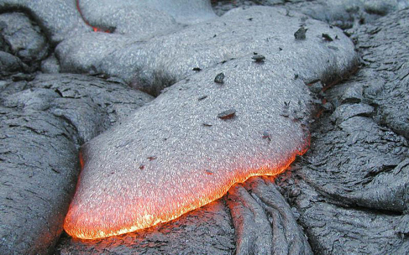
Composition of the Crust
Composition:
Oceanic Basalt and Continental Granite called Igneous Rock (any rock that has cooled from a molten state).
Sedimentary Rock: made of fragments of igneous rock or the shells of living organisms deposited by wind or water and cemented together without melting. Example: sandstones, shales, and limestones
Metamorphic Rock: produced when high temperature or pressure alters igneous or sedimentary rock physically or chemically.
Formation of Igneous Rock as Liquid Lava Cools and Freezes. This is a lava flow from a basaltic eruption. Basaltic lava flows quickly and can move easily over distances of more than 20 kilometers. (credit: USGS)
Primitive Rock: Primitive rock represents the original material out of which the planetary system was made. No primitive material is left on Earth because the entire planet was heated early in its history.

Slide 14
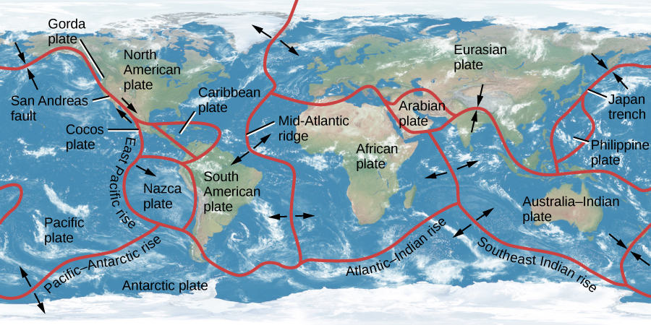
Plate Tectonics
Plate tectonics is an idea that explains how slow motions within the mantle of Earth move large segments of the crust, resulting in a gradual “drifting” of the continents as well as the formation of mountains and other large-scale geological features.
Earth’s crust and upper mantle (to a depth of about 60 kilometers) are divided into 12 tectonic plates that fit together like the pieces of a jigsaw puzzle.
Earth’s Continental Plates. This map shows the major plates into which the crust of Earth is divided. Arrows indicate the motion of the plates at average speeds of 4 to 5 centimeters per year, similar to the rate at which your hair grows.

Slide 15
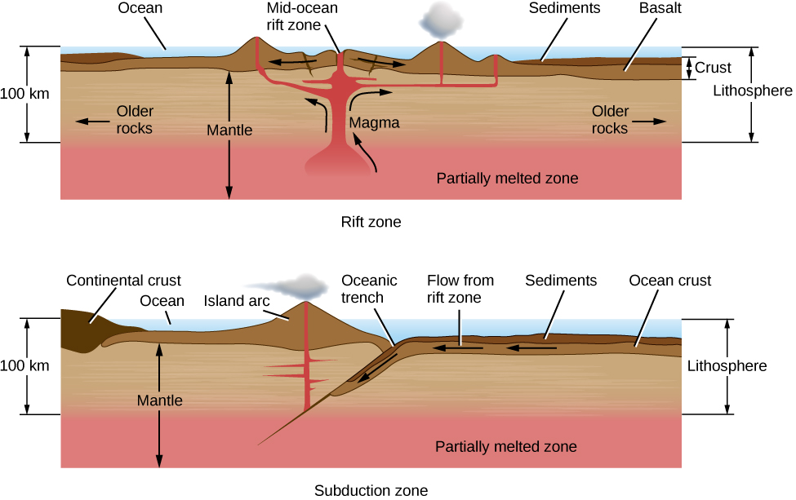
Rift and Subduction Zones
Plates pull apart from each other along Rift Zones
When two plates come together, one plate is often forced beneath another in what is called a Subduction Zone
All along the subduction zone, earthquakes and volcanoes mark the death throes of the plate (Japan trench).
Rift Zone and Subduction Zone. Rift and subduction zones are the regions (mostly beneath the oceans) where new crust is formed and old crust is destroyed as part of the cycle of plate tectonics.

Slide 16
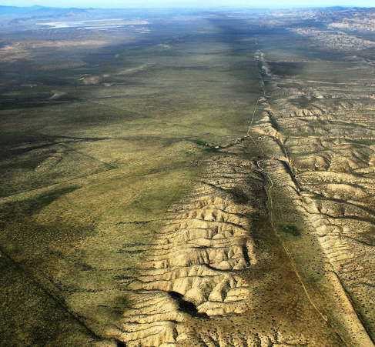
Fault Zones and Mountain Building
Along much of their length, the crustal plates slide parallel to each other.
These plate boundaries are marked by cracks or faults.
San Andreas Fault in California lies at the boundary between the Pacific plate and the North American plate
The Pacific plate, to the west, is moving northward, carrying Los Angeles, San Diego, and parts of the southern California coast with it.
In several million years, Los Angeles may be an island off the coast of San Francisco.
San Andreas Fault. We see part of a very active region in California where one crustal plate is sliding sideways with respect to the other. The fault is marked by the valley running up the right side of the photo. Major slippages along this fault can produce extremely destructive earthquakes. (credit: John Wiley)

Slide 17
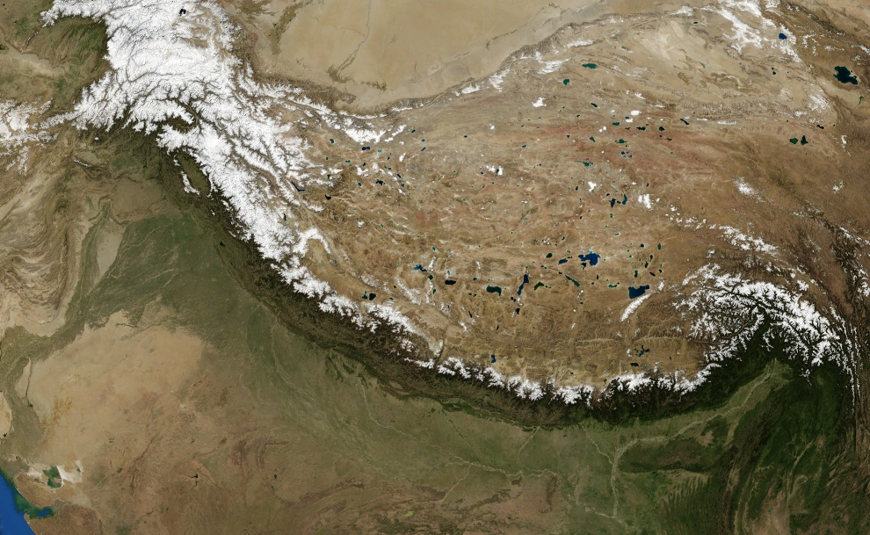
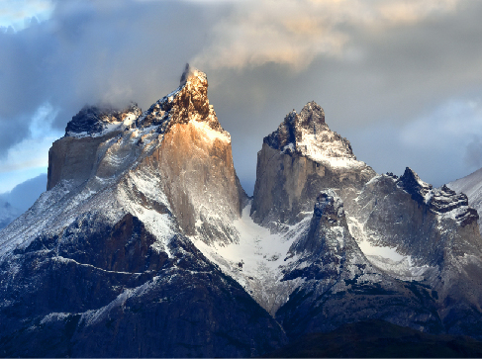
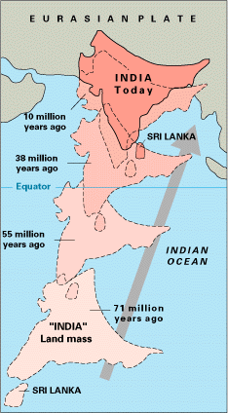
Fault Zones and Mountain Building
Himalayas as pictured by NASA Landsat 7 Satellite.
Mountains on Earth. The Torres del Paine are a young region of Earth’s crust where sharp mountain peaks are being sculpted by glaciers. We owe the beauty of our young, steep mountains to the erosion by ice and water. (credit: David Morrison)
The 6,000-kilometre-plus (3,700 mi) journey of the India landmass (Indian Plate) before its collision with Asia (Eurasian Plate) about 40 to 50 million years ago

Slide 18
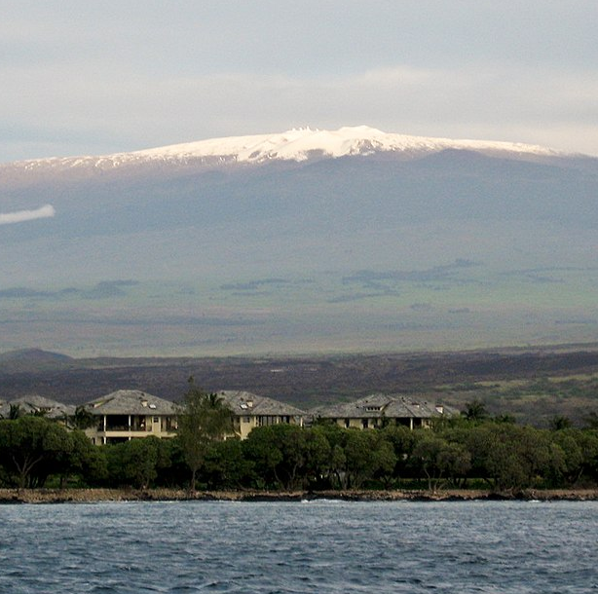
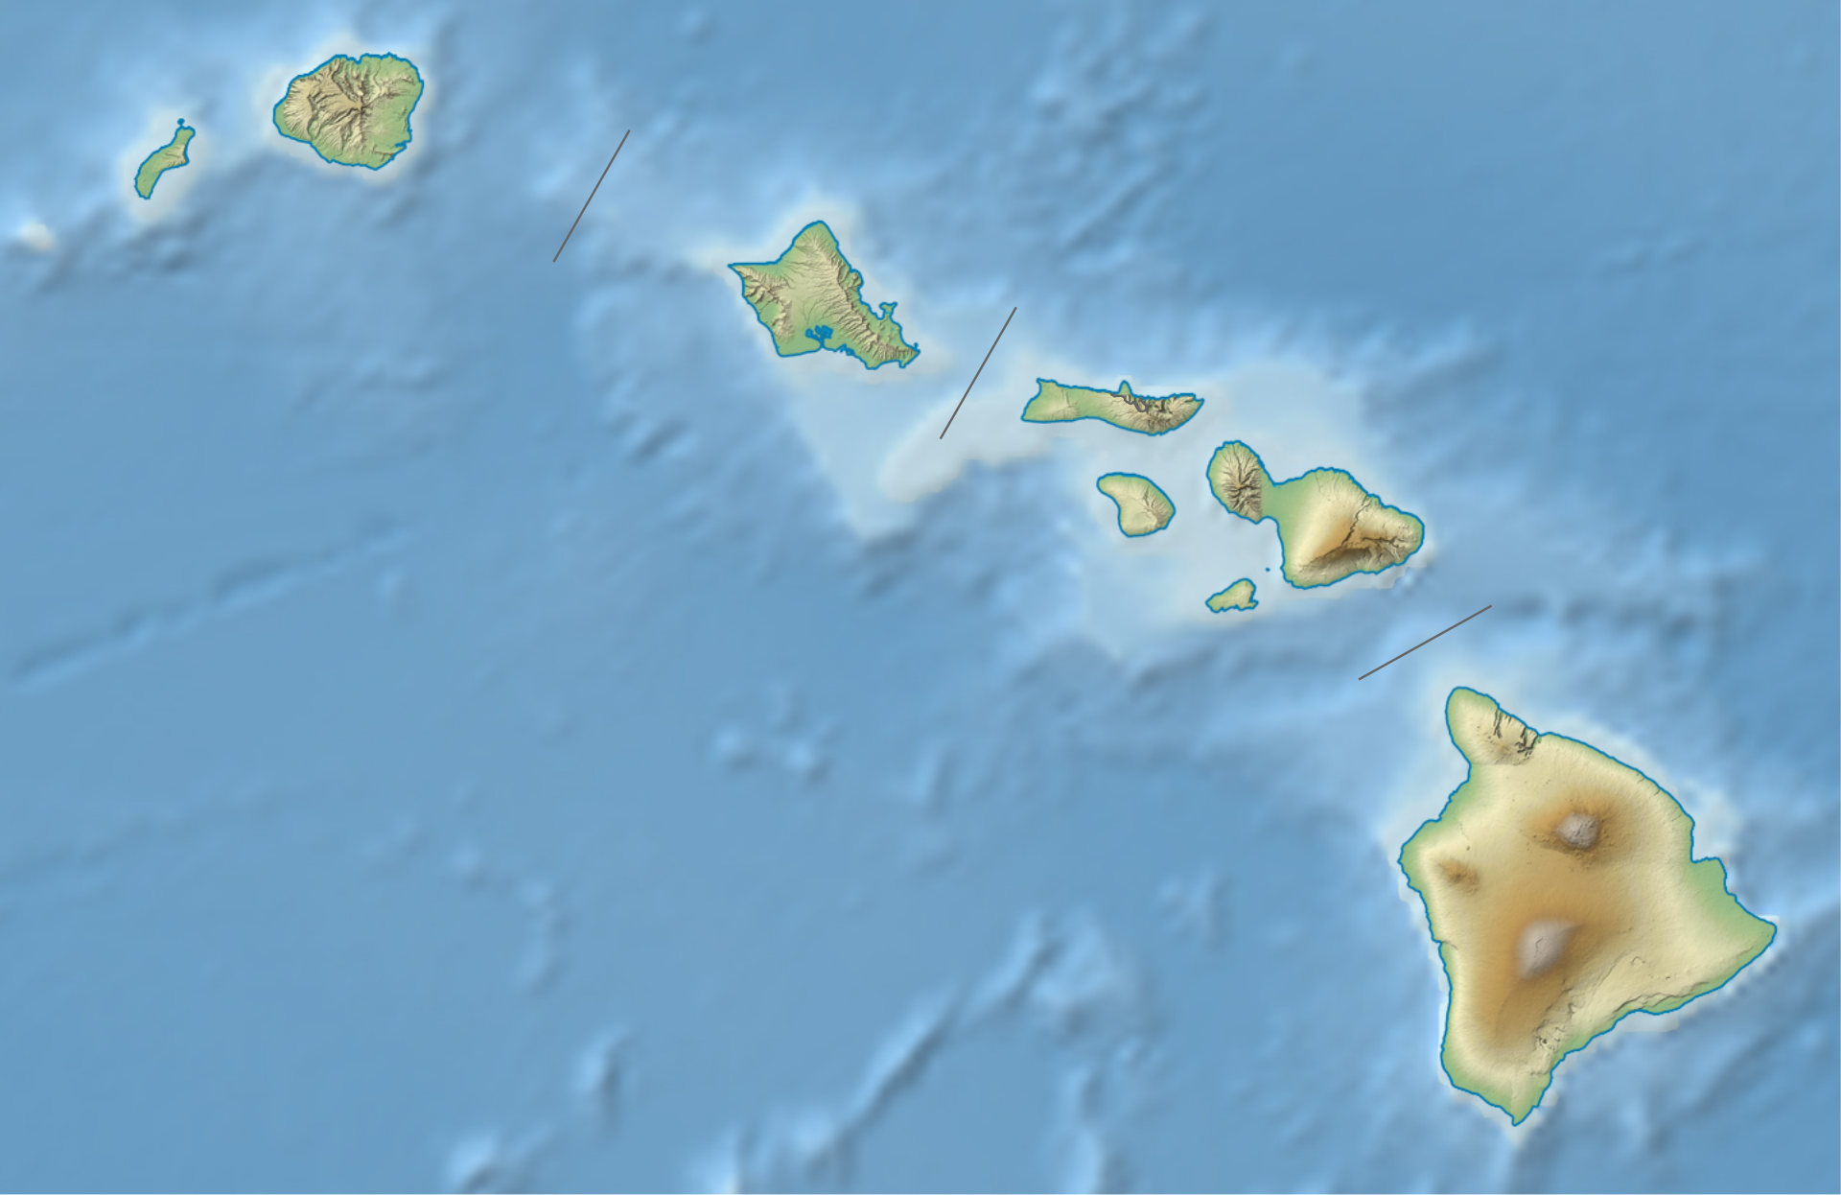
Volcanoes
Volcanoes mark locations where lava rises to the surface. One example is mid ocean ridges, which are long undersea mountain ranges formed by lava rising from Earth’s mantle at plate boundaries.
A second major kind of volcanic activity is associated with subduction zones, and volcanoes sometimes also appear in regions where continental plates are colliding.
In each case, the volcanic activity gives us a way to sample some of the material from deeper within our planet.
The Hawaii hot spot has been active for at least 100 million years.
As Earth’s plates have moved during that time, the hot spot has generated a 3500-kilometer-long chain of volcanic islands.
The tallest Hawaiian volcanoes are among the largest individual mountains on Earth, more than 100 kilometers in diameter and rising 9 kilometers above the ocean floor.

Slide 19
Chapter 8
EARTH AS A PLANET
8.1 The Global Perspective
8.2 Earth’s Crust
8.3 Earth’s Atmosphere
8.4 Life, Chemical Evolution, and Climate Change
8.5 Cosmic Influences on the Evolution of Earth
By the end of this section, you will be able to:
Differentiate between Earth’s various atmospheric layers
Describe the chemical composition and possible origins of our atmosphere
Explain the difference between weather and climate

Slide 20
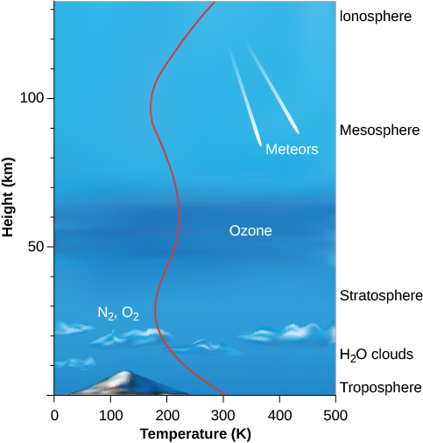
Structure of the Atmosphere
The atmosphere exerts a pressure at sea level defined as 1 bar
1 square centimeter of Earth’s surface has a weight equivalent to 1.03 kilograms
The total mass of Earth’s atmosphere is about 5 × 10¹⁸ kilograms. This sounds like a large number, but it is only about a millionth of the total mass of Earth.
Most of the atmosphere is concentrated near the surface of the Earth, within10 kilometers (Troposphere).
Most of the Stratosphere, which extends to about 50 kilometers above the surface, is cold and free of clouds.
The Ozone layer protects the surface from some of the Sun’s dangerous ultraviolet radiation.
Height increases up the left side of the diagram, and the names of the different atmospheric layers are shown at the right. In the upper ionosphere, ultraviolet radiation from the Sun can strip electrons from their atoms, leaving the atmosphere ionized. The curving red line shows the temperature (see the scale on the x-axis).

Slide 21
Structure of the Atmosphere
Mesosphere: Coldest layer of Earth’s atmosphere (130 below zero). Space rocks burn here.
In the Ionosphere (100 KM and high), atoms are ionized by the loss of an electron. Atoms can escape the gravity field of the Earth.
Atmospheric leakage also created Mars’ thin atmosphere. Venus’ dry atmosphere evolved because its proximity to the Sun vaporized and dissociated any water, with the component gases lost to space.
Height increases up the left side of the diagram, and the names of the different atmospheric layers are shown at the right. In the upper ionosphere, ultraviolet radiation from the Sun can strip electrons from their atoms, leaving the atmosphere ionized. The curving red line shows the temperature (see the scale on the x-axis).

Slide 22
Atmospheric Composition and Origin
At Earth’s surface, the atmosphere consists of
78% nitrogen (N₂)
21% oxygen (O₂)
1% argon (Ar)
traces of water vapor (H₂O), carbon dioxide (CO₂), and other gases.
Variable amounts of dust particles and water droplets are also found suspended in the air.
On a Hotter Earth:
300 bars of water (vaporized oceans)
70 bars of CO₂ (sedimentary carbonate rocks)
Where did our planet’s original atmosphere come from?
the atmosphere could have been formed with the rest of Earth as it accumulated from debris left over from the formation of the Sun;
it could have been released from the interior through volcanic activity, subsequent to the formation of Earth;
it may have been derived from impacts by comets and asteroids from the outer parts of the solar system.

Slide 23
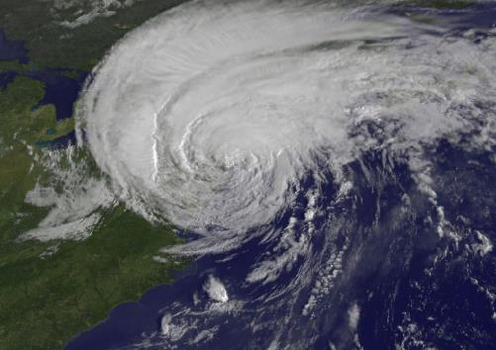
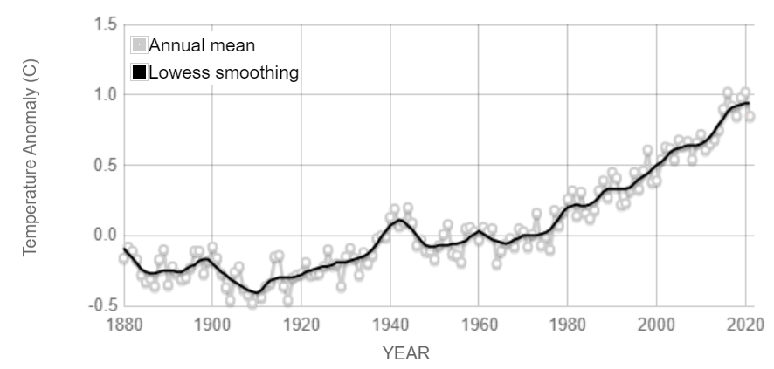
Weather and climate
All planets with atmospheres have weather.
The energy that powers the weather is derived primarily from the sunlight that heats the surface.
The atmosphere and oceans redistribute the heat from warmer to cooler areas.
Climate is a term used to refer to the effects of the atmosphere that last through decades and centuries.
Storm from Space. This satellite image shows Hurricane Irene in 2011, shortly before the storm hit land in New York City. The combination of Earth’s tilted axis of rotation, moderately rapid rotation, and oceans of liquid water can lead to violent weather on our planet. (credit: NASA/NOAA GOES Project)
Earth’s surface continues to significantly warm, with recent global temperatures being the hottest in the past 2,000-plus years. This graph illustrates the change in global surface temperature relative to 1951-1980 average temperatures. (Climate.nasa.gov)

Slide 24
Chapter 8
EARTH AS A PLANET
8.1 The Global Perspective
8.2 Earth’s Crust
8.3 Earth’s Atmosphere
8.4 Life, Chemical Evolution, and Climate Change
8.5 Cosmic Influences on the Evolution of Earth
By the end of these sections, you will be able to:
Outline the origins and subsequent diversity of life on Earth
Explain the ways that life and geological activity have influenced the evolution of the atmosphere
Describe the causes and effects of the atmospheric greenhouse effect and global warming
Describe the impact of human activity on our planet’s atmosphere and ecology
Explain the scarcity of impact craters on Earth compared with other planets and moons
Describe the evidence for recent impacts on Earth
Detail how a massive impact changed the conditions for life on Earth, leading to the extinction of the dinosaurs

Slide 25
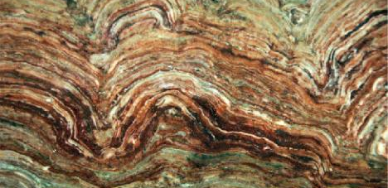
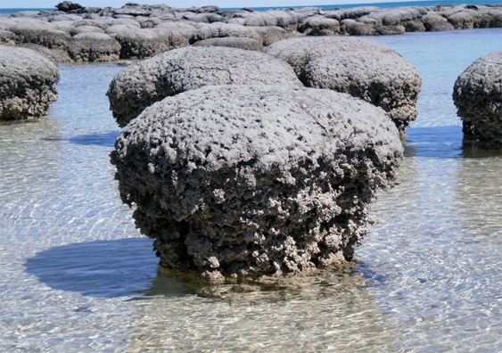
The origin of life
Earth seems to be the only planet in the solar system with life.
3.5 billion years ago, life had achieved the sophistication to build large colonies called stromatolites
Millions of years after Earth’s formation, life (perhaps little more than large molecules, like the viruses of today) probably existed in warm, nutrient-rich seas, living off accumulated organic chemicals.
When this easily accessible food became depleted, life began the long evolutionary road that led to the vast numbers of different organisms on Earth today.
Fossil Stromatolites. This fossilized colony of stromatolites dates to the Precambrian Era. The layered, domelike structures are mats of sediment trapped in shallow waters by large numbers of blue-green bacteria that can photosynthesize.(credit: James St. John)
UNSW Sydney

Slide 26
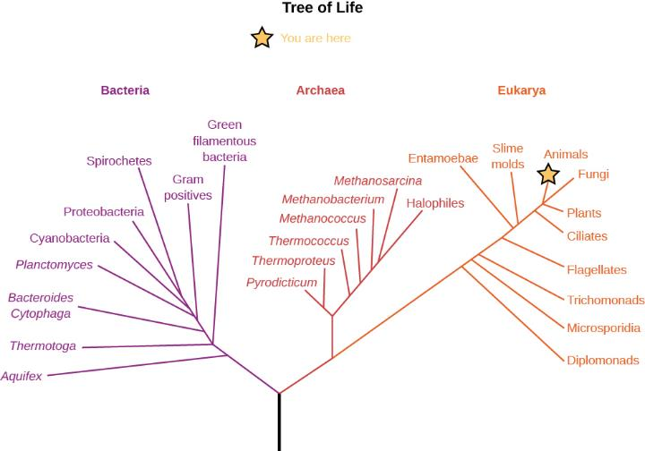
Genetics and Genomics—the study of the genetic code that is shared by all life on Earth.
Your genome, the complete map of the DNA in your body, is identical at the 99.9% level to that of Julius Caesar or Marie Curie.
At the 99% level, human and chimpanzee genomes are the same.
By looking at the gene sequences of many organisms, we can determine that all life on Earth is descended from a common ancestor, and we can use the genetic variations among species as a measure of how closely different species are related.
Tree of Life. This chart shows the main subdivisions of life on Earth and how they are related. Note that the animal and plant kingdoms are just short branches on the far right, along with the fungi. The most fundamental division of Earth’s living things is onto three large domains called bacteria, archaea, and eukarya. Most of the species listed are microscopic. (credit: modification of work by Eric Gaba)

Slide 27
The Evolution of the Atmosphere
One of the key steps in the evolution of life on Earth was the development of blue-green algae, a very successful life-form that takes in carbon dioxide from the environment and releases oxygen as a waste product.
These successful microorganisms proliferated, giving rise to all the lifeforms we call plants.
Since the energy for making new plant material from chemical building blocks comes from sunlight, we call the process photosynthesis.
Free oxygen began accumulating in the atmosphere about 2 billion years ago, and the increased amount of this gas led to the formation of Earth’s ozone layer.
The presence of oxygen allowed colonization of the land. It also made possible a tremendous proliferation of animals, which lived by taking in and using the organic materials produced by plants as their own energy source.
We are lifeforms that have evolved to breathe in the waste product of plants.

Slide 28
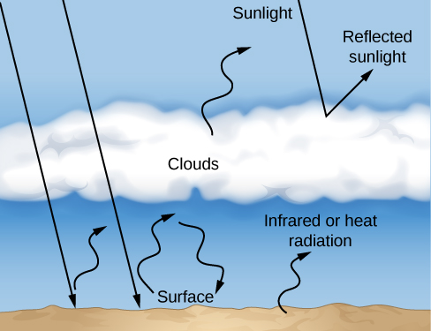
The Greenhouse Effect and Global Warming
How the Greenhouse Effect Works. Sunlight that penetrates to Earth’s lower atmosphere and surface is reradiated as infrared or heat radiation, which is trapped by greenhouse gases such as water vapor, methane, and CO₂ in the atmosphere. The result is a higher surface temperature for our planet.

Slide 29
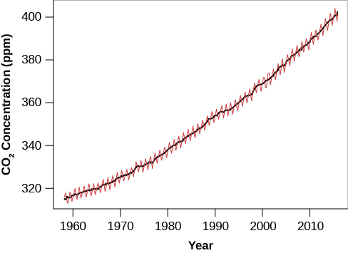
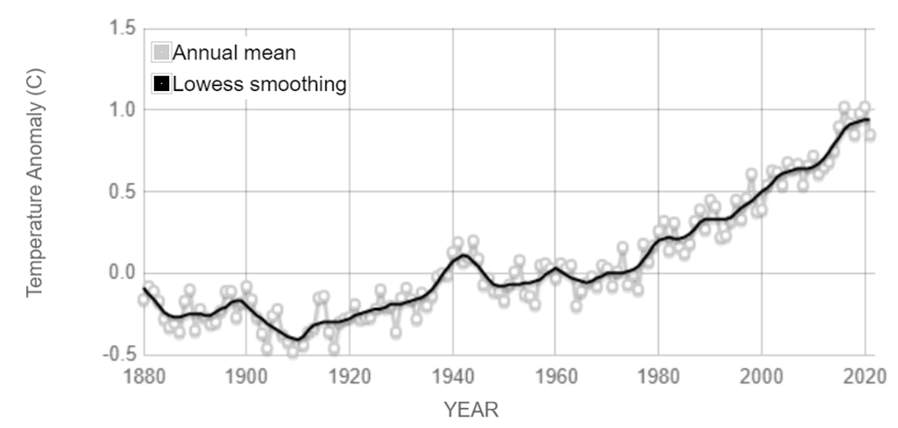
Human Impacts on Our Planet
Before the end of the present century, Earth’s CO₂ level is predicted to reach twice the value it had before the industrial revolution
Around the world, temperature records are constantly set and broken; all but one of the hottest recorded years have taken place since 2000.
Glaciers are retreating, and the Arctic Sea ice is now much thinner than when it was first explored with nuclear submarines in the 1950s.
Although not an officially approved name, the concept of “anthropocene” is useful for recognizing that we humans now represent the dominant influence on our planet’s atmosphere and ecology, for better or for worse.
Increase of Atmospheric Carbon Dioxide over Time. Scientists expect that the amount of CO₂ will double its preindustrial level before the end of the twenty-first century. Measurements of the isotopic signatures of this added CO₂ demonstrate that it is mostly coming from burning fossil fuels. (credit: modification of work by NOAA)

Slide 30
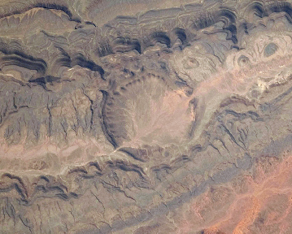
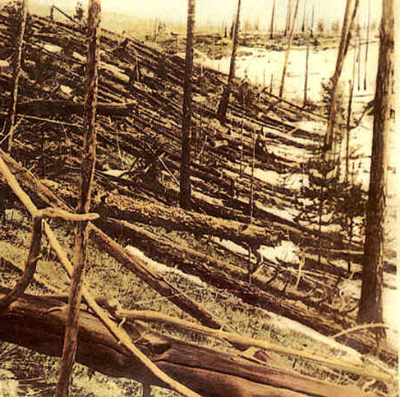
Cosmic Influences on the Evolution of Earth
In the course of its history, Earth have been impacted as heavily as the Moon.
But these craters are destroyed by our active geology before they can accumulate.
These impacts had an important influence on the evolution of life.
Ouarkziz Impact Crater. Located in Algeria, this 4-km-wide crater is the result of a meteor impact during the Cretaceous period. Although the crater has experienced heavy erosion, this image from the International Space Station shows the circular pattern resulting from impact. (credit: modification of work by NASA)
Aftermath of the Tunguska Explosion. This photograph, taken 19 years after the blast, shows a part of the forest that was destroyed by the 5-megaton explosion, resulting when a stony projectile about the size of a small office building (40 meters in diameter) collided with our planet. (credit: modification of work by Leonid Kulik)

Slide 31
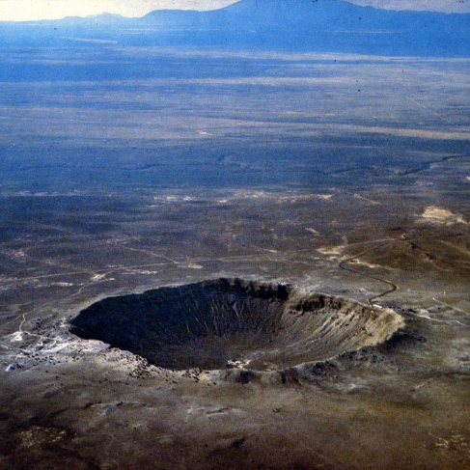
The Arizona crater
The best-known recent crater on Earth was formed about 50,000 years ago in Arizona. The projectile in this case was a lump of iron about 40 meters in diameter. Now called Meteor Crater and a major tourist attraction on the way to the Grand Canyon, the crater is about a mile across and has all the features associated with similar-size lunar impact craters.
Meteor Crater is one of the few impact features on Earth that remains relatively intact; some older craters are so eroded that only a trained eye can distinguish them. Nevertheless, more than 150 have been identified.
Meteor Crater in Arizona. Here we see a 50,000-year-old impact crater made by the collision of a 40-meter lump of iron with our planet. Although impact craters are common on less active bodies such as the Moon, this is one of the very few well-preserved craters on Earth. (modification of work by D. Roddy/USGS)

Slide 32
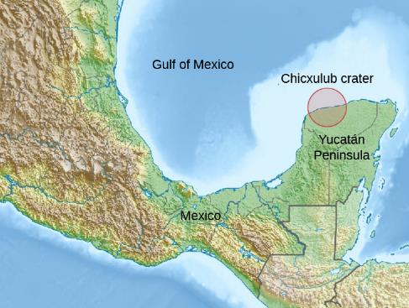
Mass extinction
The best-documented large impact took place 65 million years ago, at the end of what is now called the Cretaceous period of geological history.
This time in the history of life on Earth was marked by a mass extinction, in which more than half of the species on our planet died out.
Its mass must have been more than a trillion tons, determined from study of a worldwide layer of sediment deposited from the dust cloud that enveloped the planet after its impact.
Site of the Chicxulub Crater. This map shows the location of the impact crater created 65 million years ago on Mexico’s Yucatán peninsula. The crater is now buried under more than 500 meters of sediment. (credit: modification of work by “Carport”/Wikimedia)
Such a quantity of airborne material would have blocked sunlight completely, plunging Earth into a period of cold and darkness that lasted several months. Many plants dependent on sunlight would have died, leaving plant-eating animals without a food supply. Other worldwide effects included large-scale that destroyed much of the planet’s forests and grasslands, and a long period in which rainwater around the globe was acidic. It was these environmental effects, rather than the explosion itself, that were responsible for the mass extinction, including the demise of the dinosaurs.

Slide 33
End of the Chapter
This OpenStax ancillary resource is © Rice University under a CC-BY 4.0 International license; it may be reproduced or modified but must be attributed to OpenStax, Rice University and any changes must be noted.

